Slide 1
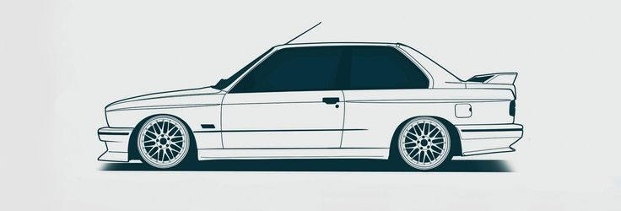
Predicting the price of used cars using machine learning techniques
Florian Zunhammer
September 2017

Slide 2
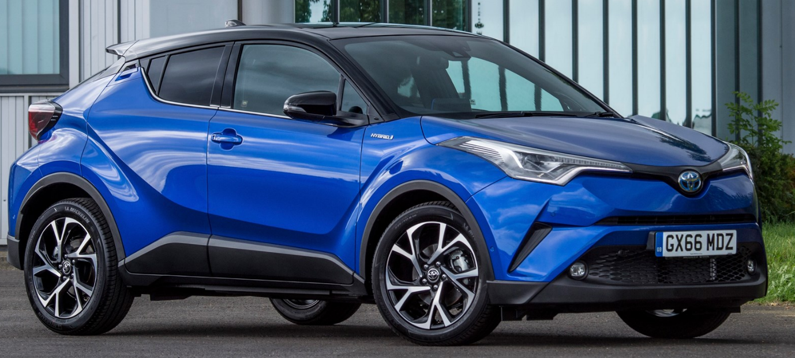
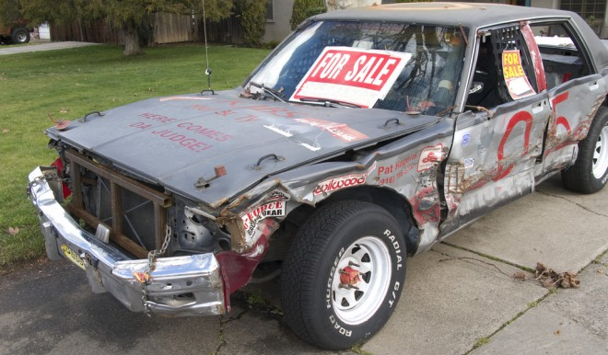
Motivation

Slide 3
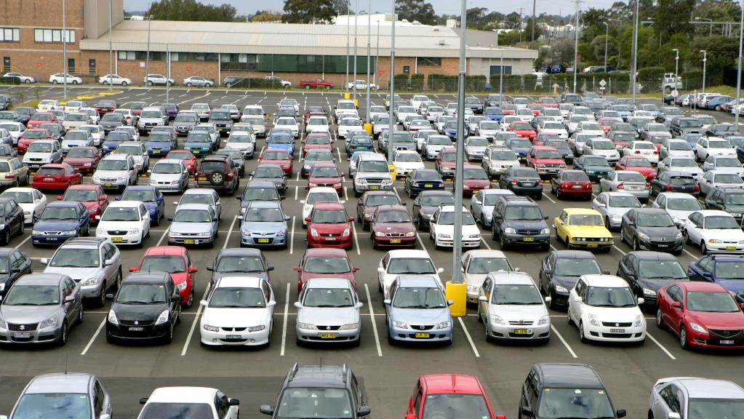
Motivation

Slide 4
Publications
Pudaruth, S. Predicting the Price of Used Cars using Machine Learning Techniques. Int. J. Inf. Comput. Technol. 4, 753–764 (2014).
97 records, r²=0.85
Noor, K. & Jan, S. Vehicle Price Prediction System using Machine Learning Techniques. 167, 27–31 (2017).
1699 records, r²=0.98
other GitHub projects:
https://github.com/dkeske/CarPrice
https://github.com/celikmustafa89/usedCarDatabase
https://github.com/xiaofeifei1800/Car-price-Prediction

Slide 5
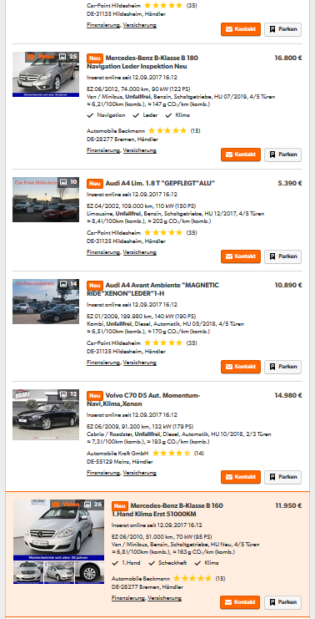
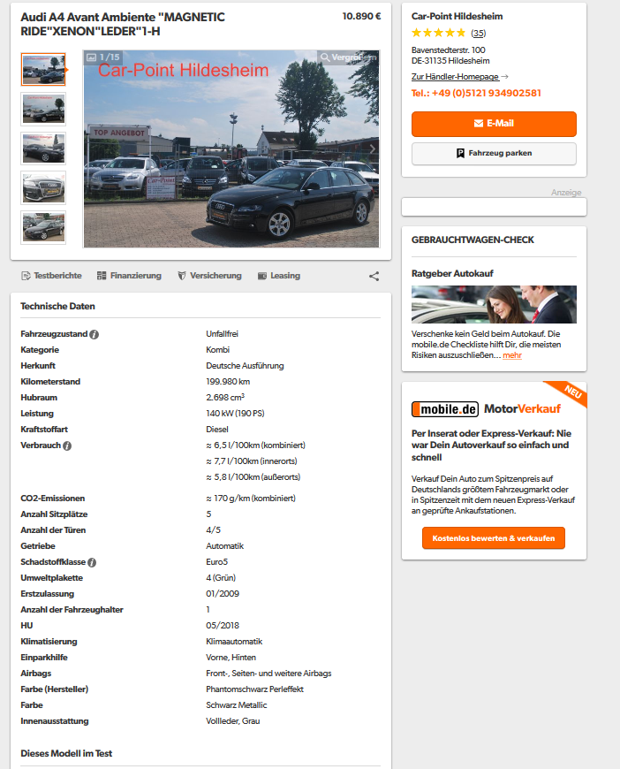

Data Mining
mobile.de
Database
…

Slide 6
Data Processing
for now: only numerical data
Outlier removal (data errors, oldtimers, etc…)
Removal of ads with missing data
feature normalization
Features
fuel type
consumption
emission
cubic capacity
power
mileage
year first registered
price < 10.000€
76.972 entries
after preprocessing:
48.072 car ads
→ 48.072 x 8 data matrix

Slide 7
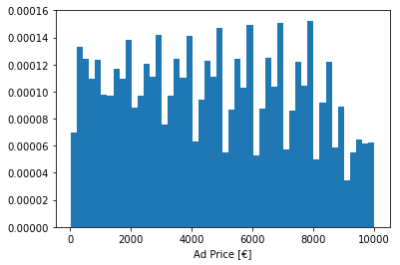
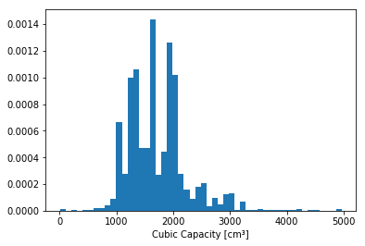
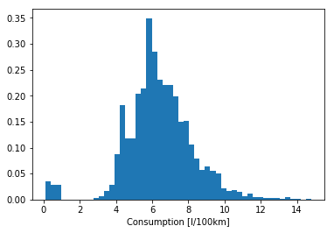
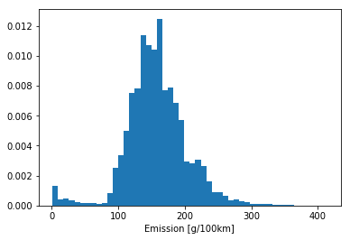
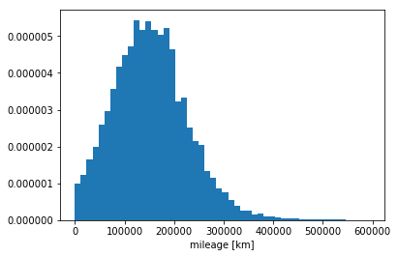
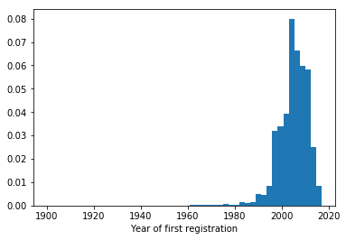
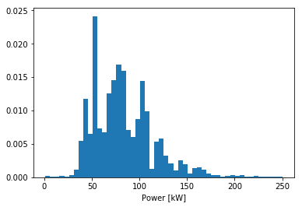
Data overview

Slide 8
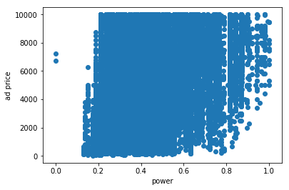
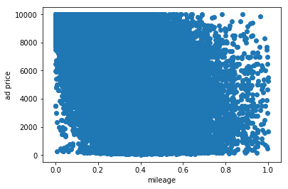
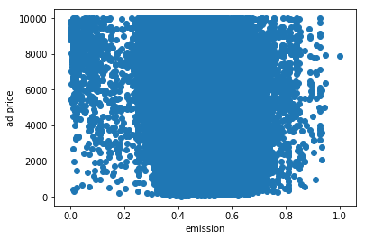
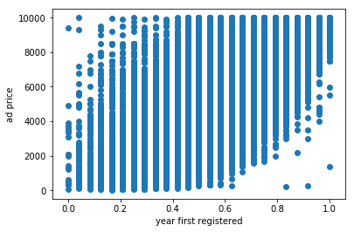
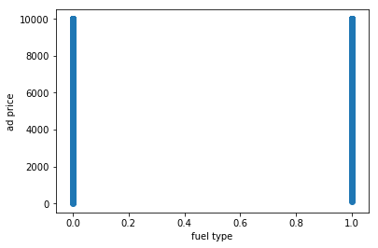
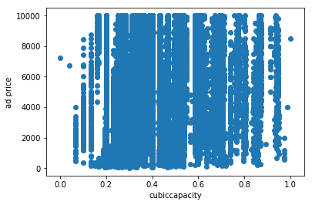
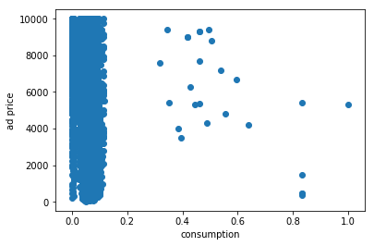
Data overview

Slide 9
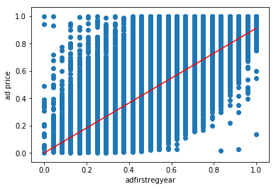
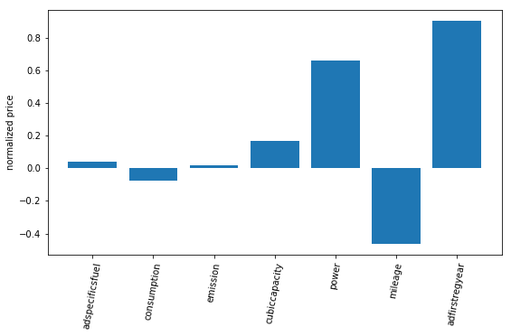
Multivariate linear regression
7 features | r² score
training set | 73.03%
test set | 71.06%
validation set | 70.99%

Slide 10
Multivariate linear regression
Additional features:
car make (e.g. Ford, Opel, Chrysler, …) → 53 features
car model (e.g. Escort, Astra, Voyager, ...) → 123 features
category (e.g. Van, Cabrio, Kombi, …) → 20 features
48,072 x 204 data matrix

Slide 11
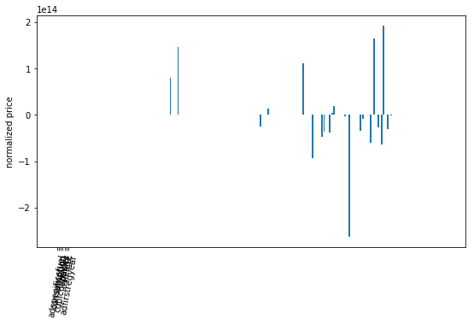
Multivariate linear regression
203 features | r² score
training set | 81.34%
test set | -4.43e20
validation set | -5.44e21

Slide 12
Support vector machine
203 features poly. kernel | r² score
training set | 86.24%
test set | 83.20%
validation set | 83.23%
203 features linear kernel | r² score
training set | 81.39%
test set | 79.43%
validation set | 79.05%
8 features linear kernel | r² score
training set | 73.00%
test set | 71.66%
validation set | 71.16%
svm parameters not optimized: gamma=0.1, C=1.0

Slide 13
Summary
Data mining
html scraping from mobile.de
storage of the data in an SQL database
in total 48,072 processed car ads available
Data analysis
Linear regression yields a usable model for the prediction of car prices
Linear regression model fails when the complexity of the data is too high
SVM models are able to deal with more complex data
non-linear models seem to have a better prediction quality than linear models
Discussion
compared to other publications, the regression scores are a bit low
the great amount of variance in this dataset might decrease the quality of the results
For better results, even more data could be collected and natural language processing could be used (e.g. find “TÜV” or “no TÜV” as keywords)

Slide 14

Thank you for your attention

Slide 15
Credentials
Slide 1: https://www.pinterest.de/pin/713679872170088360/
Slide 2: http://www.mostreliablecarbrands.com/de/these-are-the-finalists-car-of-the-year-in-europe/
http://www.checkcity.com/blog/2013/04/how-to-purchase-a-used-car-that-will-last/
Slide 3: http://cdn.newsapi.com.au/image/v1/9aceaf33b0dec46654cd8b6575c2980e?width=1024
Slide 5: http://www.moblie.de
Slide 14: http://www.bodo-ramelow.de/uploads/pics/lustiges_auto.jpg

